Slide 1
Week 2
Slide deck is originally Dr. Berman’s from CS 7041.

Slide 2
Unit Test
VS 2017 Unit Test Reference
https://msdn.microsoft.com/en-us/library/hh598953.aspx

Slide 3
Unit Test
Overview of Steps
Create a Native Test Project
Create a DLL Project
Make Tests

Slide 4
Test Driven Development (TDD)
From Wikipedia –
is a software development process that relies on the repetition of a very short development cycle: Requirements are turned into very specific test cases, then the software is improved to pass the new tests, only. This is opposed to software development that allows software to be added that is not proven to meet requirements.

Slide 5
Converting Numbers on Base to Another
Problem Notebook:
Can you think of an algorithm to convert a number from one base to another?

Slide 6
Converting Numbers on Base to Another
12/2 = 6 + 0
6/2 = 3 + 0
3/2 = 1 + 1
1/2 = 0 + 1
12=1100

Slide 7
Converting Numbers on Base to Another
45/16 = 2 + 15(D)
2/16 = 0 + 2
45=2D

Slide 8
Converting Numbers on Base to Another
45/16 = 2 + 15(D)
2/16 = 0 + 2
45=2D

Slide 9
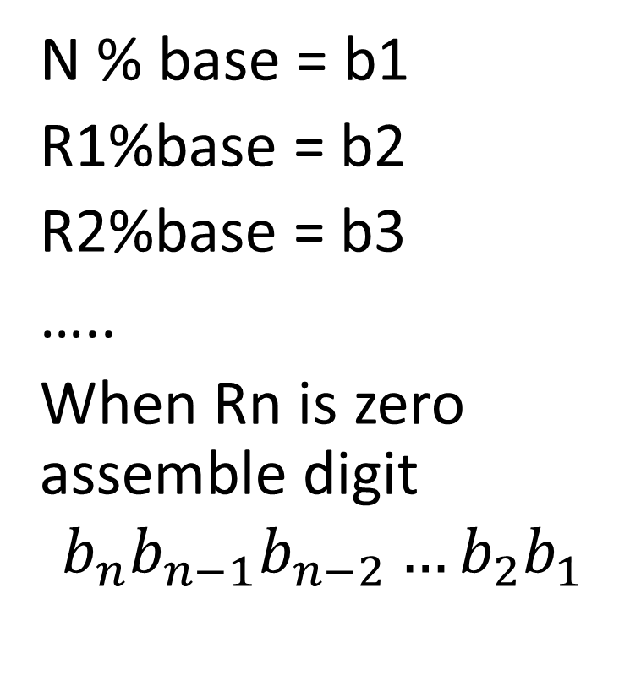
Converting Numbers on Base to Another
N / base = R1
R1/base = R2
R2/base = R3
…..
Until Rn is zero
N % base = b1
R1%base = b2
R2%base = b3
…..
When Rn is zero assemble digit
$$b_{n}b_{n−1}b_{n−2}…b_{2}b_{1}$$

Slide 10
Converting Numbers on Base to Another
Now lets make it recursive algorithm

Slide 11
Complexity
When dealing with complexity we measure in terms of a basic operation.

Slide 12
Complexity
Some algorithms the number of operations is the same for input of size n.
However it is more common that that the number of operations can differ inputs of size n. For these we talk about best, worst, and average case complexity.

Slide 13

Complexity
An input I to an algorithm is the data, such as numbers on with the operations of the algorithm is performed.
$F_{n}$denotes the set of all inputs of size n to an algorithm.

Slide 14

Complexity
For ${I ε F}_{n} let τ\left(I\right)$denote the number of basic operations performed when the algorithm is executed with input I.

Slide 15
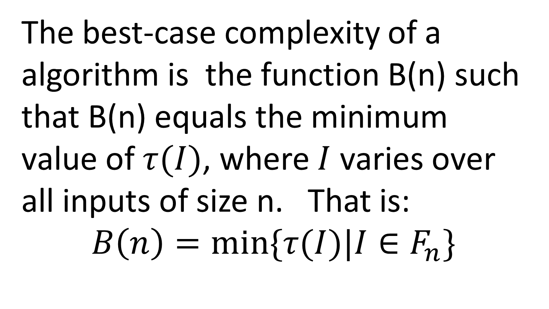
Best-Case Complexity
The best-case complexity of a algorithm is the function B(n) such that B(n) equals the minimum value of $τ(I)$, where $I$ varies over all inputs of size n. That is:
$$B\left(n\right)=min⁡\{τ(I)|I∈F_{n}\}$$

Slide 16

Worst-Case Complexity
The worst-case complexity of a algorithm is the function W(n) such that W(n) equals the maximum value of $τ(I)$, where $I$ varies over all inputs of size n. That is:
$$W\left(n\right)=max⁡\{τ(I)|I∈F_{n}\}$$

Slide 17

Average-Case Complexity
A(n) depends not only the input size of n, but also on the probability distribution on the set of all inputs of size n.
Let $p:F_{n}→\left[0,1\right]$ is a probability function defined on the input
$$A\left(n\right)=\sum_{I ε F_{n}}{τ\left(I\right)p\left(I\right)=E[τ]}$$

Slide 18
Average-Case Complexity
We’ll explore this in more detail in future weeks

Slide 19

Complexity
$$B\left(n\right)≤A(n)≤W(n)$$
And never:
$$A\left(n\right)=(W\left(n\right)−B\left(n\right))/n$$

Slide 20
Linear Search
Function LinearSearch(L[0:n-1],X)
Input: L[0:n-1] (a list of size n), X (a search item)
Output: returns index of first occurenceof X in the list, or -1 if X is not in the list
for i <- 0 to n -1 do
if X = L[i] then
return (i)
endif
endfor
return(-1)
End LinearSearch

Slide 21
Linear Search
What is B(n) and W(n) for Linear Search?

Slide 22
Binary Search
When using in index in back of the book to look up a word, how do you use it?
Start at the beginning ‘A’ and work you way to find the word
Randomly flip through the book
Flip to the middle, see if the word is before or after?

Slide 23
Binary Search
Assume L[0,n-1] is a list of items in ascending order, and mid is the index of the middle, and X is the item we are looking for
We can have three possibilities:
X = L[mid], X is found
X < L[mid], search for X in L[0:mid-1],
X > L[mid], search for X in L[mid+1:n-1]

Slide 24
Binary Search
Function BinarySearch(L[0:n-1], low, high, X)recursive
Input: L[0:n-1](an array of list elements sorted in increasing order)
Output: returns an index of an occurrence of X in the sublist L[low, high] or -1 if X is not in the sublist

Slide 25
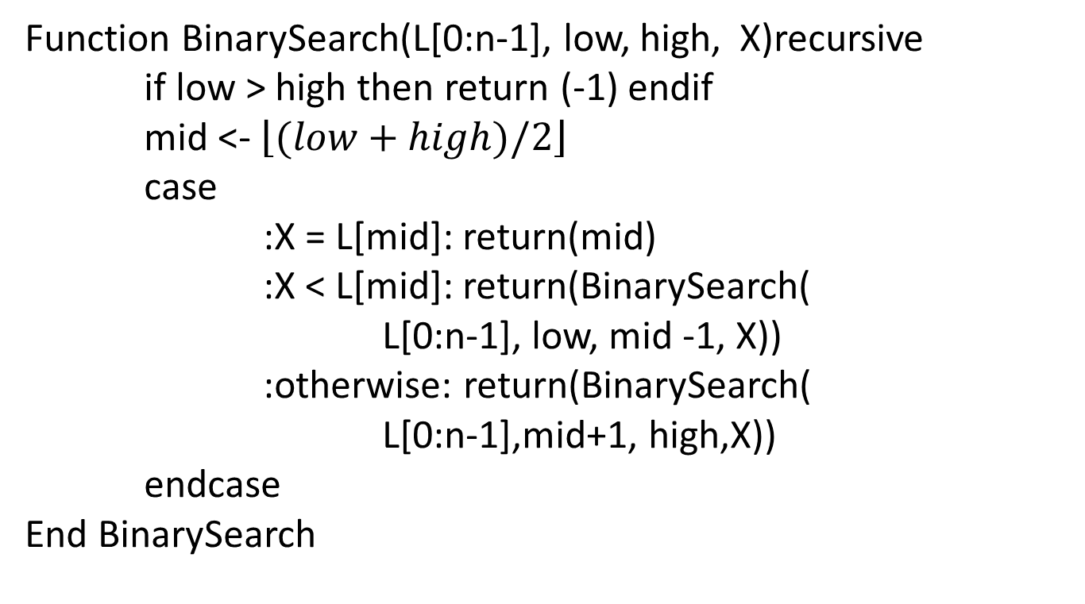
Binary Search
Function BinarySearch(L[0:n-1], low, high, X)recursive
if low > high then return (-1) endif
mid <- $\left\lfloor \left.(low+high)/2\right\rfloor \right.$
case
:X = L[mid]: return(mid)
:X < L[mid]: return(BinarySearch(
L[0:n-1], low, mid -1, X))
:otherwise: return(BinarySearch(
L[0:n-1],mid+1, high,X))
endcase
End BinarySearch

Slide 26

Binary Search
B(n) = 1 if midpoint
W(n) = 2$\left\lceil \left.\log_{2}(n+1)\right\rceil \right.$ Why?

Slide 27
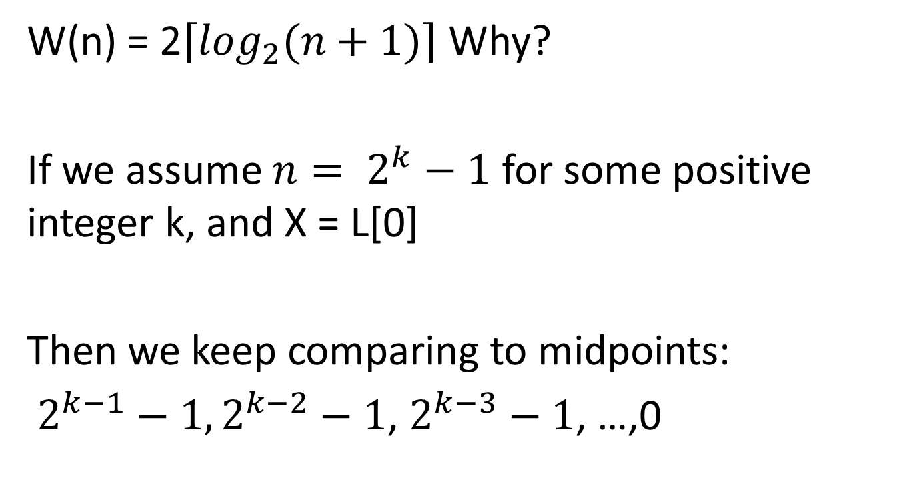
Binary Search
W(n) = 2$\left\lceil \left.\log_{2}(n+1)\right\rceil \right.$ Why?
If we assume $n= 2^{k}−1$ for some positive integer k, and X = L[0]
Then we keep comparing to midpoints:
$2^{k−1}−1, 2^{k−2}−1$, $2^{k−3}−1$, …,0

Slide 28
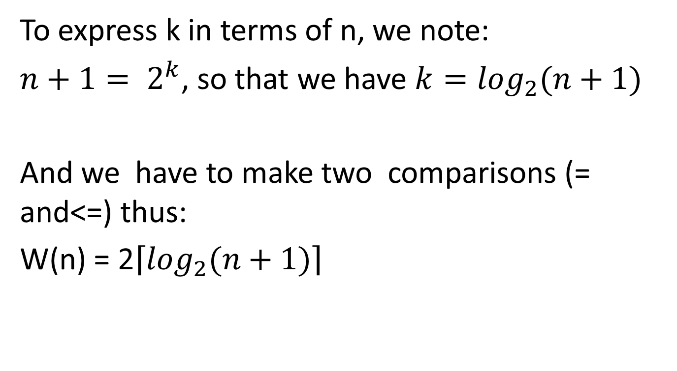
Binary Search
To express k in terms of n, we note:
$n+1= 2^{k}$, so that we have $k=\log_{2}(n+1)$
And we have to make two comparisons (= and<=) thus:
W(n) = 2$\left\lceil \left.\log_{2}(n+1)\right\rceil \right.$

Slide 29
Interpolation Search
Binary Search is akin to opening a dictionary in the middle and then going to the half point between the end or beginning, and keep repeating until you find the word you are looking for.
What happens if we use the term we are looking for as a hint of where the item may be at. For example “algorithm” is more likely to be at the middle

Slide 30
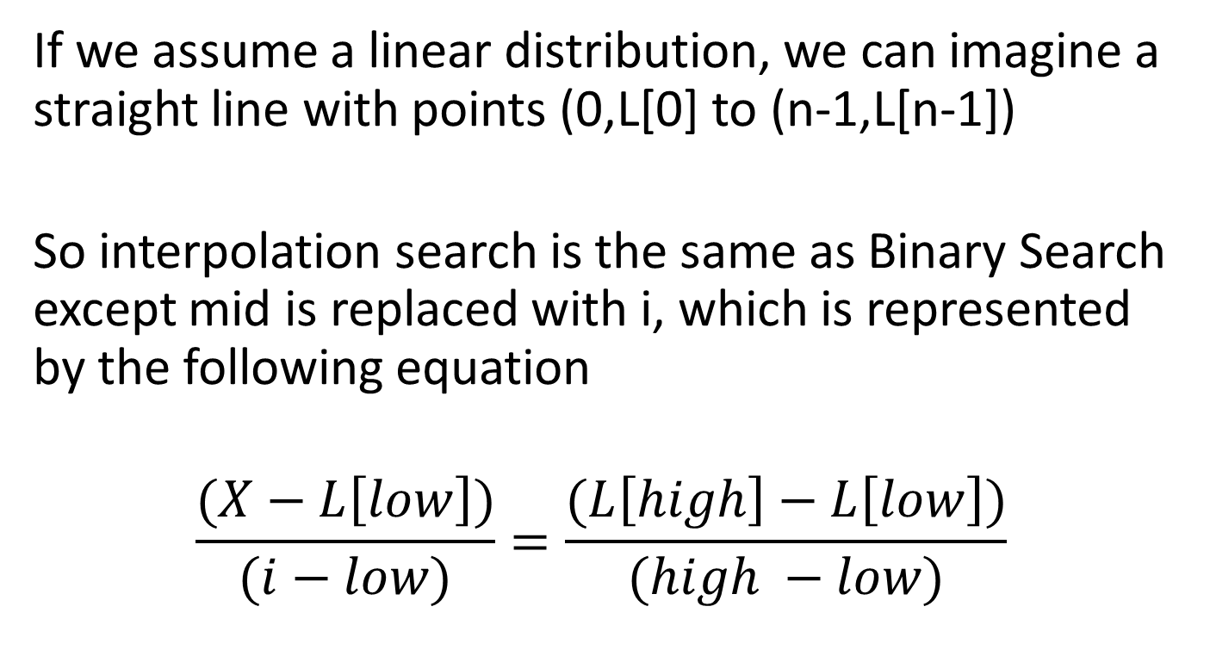
Interpolation Search
If we assume a linear distribution, we can imagine a straight line with points (0,L[0] to (n-1,L[n-1])
So interpolation search is the same as Binary Search except mid is replaced with i, which is represented by the following equation
$$\frac{(X−L\left[low\right])}{(i−low)}=\frac{(L\left[high\right]−L\left[low\right])}{(high −low)}$$

Slide 31
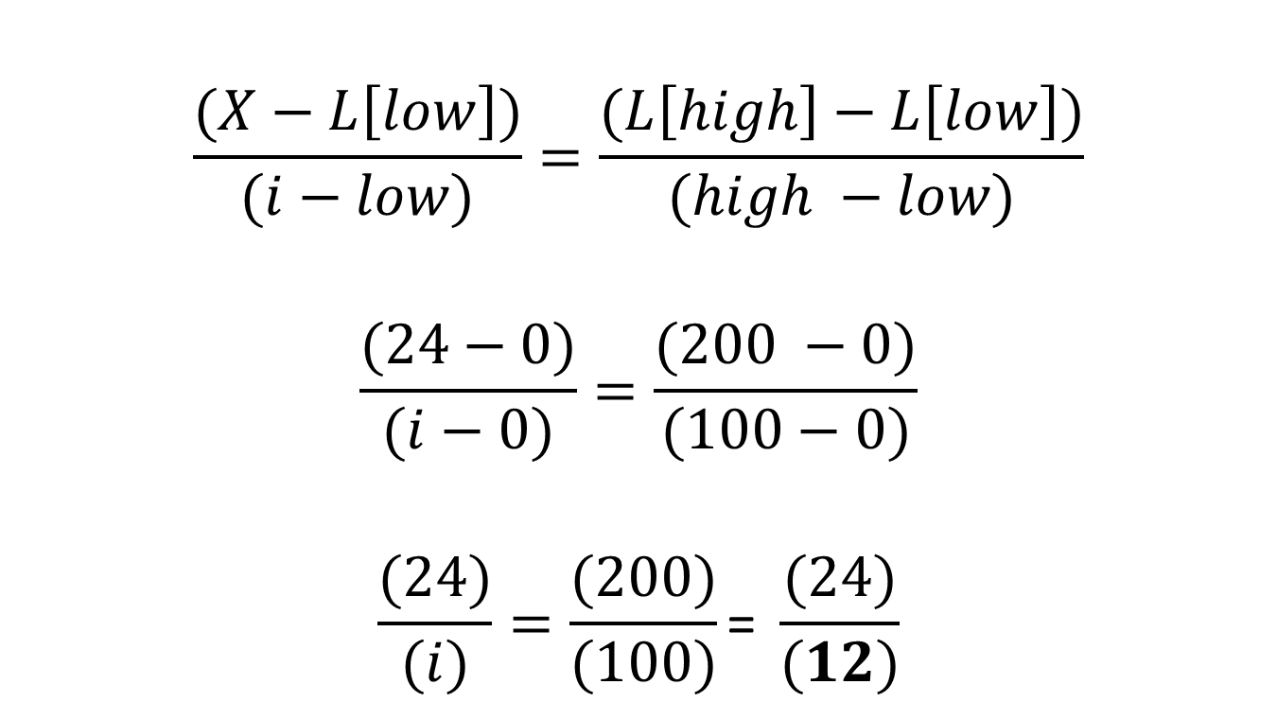
Interpolation Search
$$\frac{(X−L\left[low\right])}{(i−low)}=\frac{(L\left[high\right]−L\left[low\right])}{(high −low)}$$
$$\frac{(24−0)}{(i−0)}=\frac{(200 −0)}{(100−0)}$$
$$\frac{(24)}{(i)}=\frac{(200)}{(100)}\text{= }\frac{(24)}{(12)}$$

Slide 32
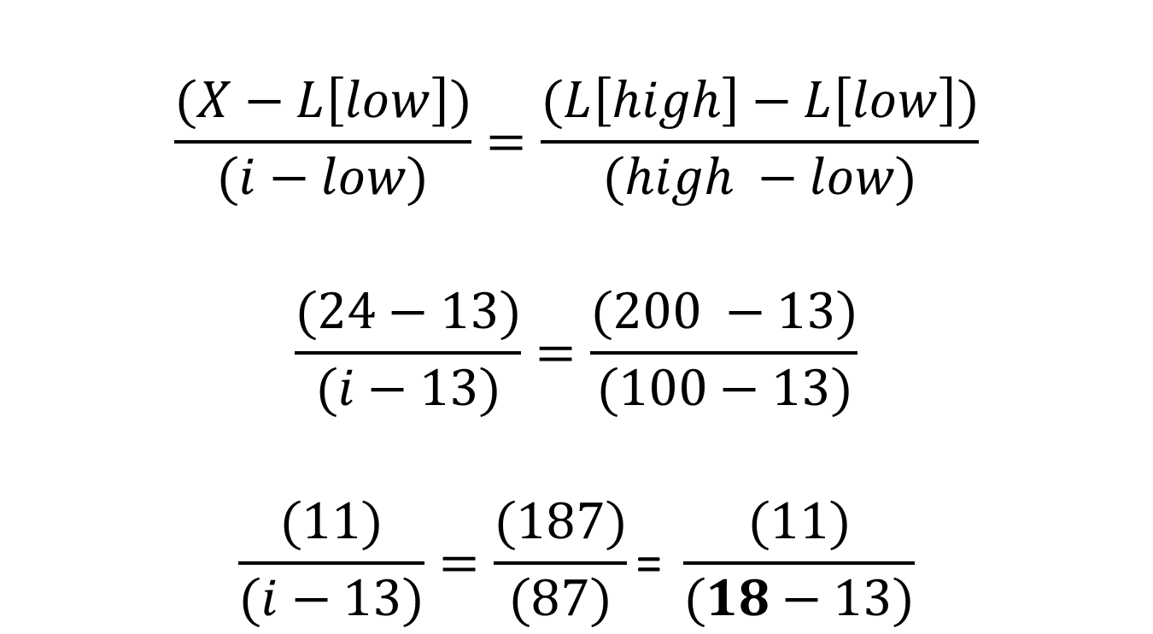
Interpolation Search
$$\frac{(X−L\left[low\right])}{(i−low)}=\frac{(L\left[high\right]−L\left[low\right])}{(high −low)}$$
$$\frac{(24−13)}{(i−13)}=\frac{(200 −13)}{(100−13)}$$
$$\frac{(11)}{(i−13)}=\frac{(187)}{(87)}\text{= }\frac{(11)}{(18−13)}$$

Slide 33
Interpolation Search
It is outside of this class, but the A(n) of interpolation search is log2(log2(n)) which is a very slow growing function.
What is the worst case complexity?

Slide 34
Interpolation Search
What is the worst case complexity?
W(n)=n

Slide 35
Max and Min in List
Consider a list of integers that is unsorted. And we want to find the max or min in the list. How should we proceed?

Slide 36
Max and Min in List
We can alter LinearSearch
Function Max (L[0:n-1])
Input:L[0,n-1] ( a list of size n)
Output: returns the max value occurring in L[0:n-1]
MaxValue = L[0]
for i = 1 to n-1 do
if L[1] > MaxValue then
MaxValue = L[i]
endif
endfor
return(MaxValue)
End Max

Slide 37
Max and Min in List
Basic operation is comparison (that dominates)
What is best, worst, and average complexity?

Slide 38
Max and Min in List
B(n) = W(n) = A(n) = n-1
Why?

Slide 39
Max and Min in List
B(n) = W(n) = A(n) = n-1
Why?

Slide 40
Max and Min in List
To find both the max and min we could call Max and Min (replace the logic in Max to look for the smallest value). And we would get B(n)=W(n)=2n-2
Famous question, can we do better?

Slide 41

Max and Min in List
Famous question, can we do better? The answer is yes, it turns out the best that can be achieved is $\left\lceil \left.\frac{3n}{2}\right\rceil −2\right.$.

Slide 42
Max and Min in List
M&M(A,B, MaxValue,MinValue)
Input: A,B
Output: MaxValue, MinValue (the maximum and minimum of A and B)
if A>=B then
MaxValue = A
MinValue = B
else
MaxValue = B
MinValue = A
endif
end M&M

Slide 43
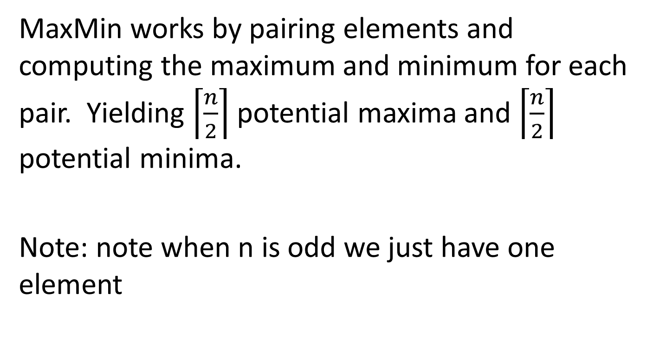
Max and Min in List
MaxMin works by pairing elements and computing the maximum and minimum for each pair. Yielding $\left\lceil \left.\frac{n}{2}\right\rceil \right.$ potential maxima and $\left\lceil \left.\frac{n}{2}\right\rceil \right.$ potential minima.
Note: note when n is odd we just have one element

Slide 44
Max and Min in List
MaxMin(L[0:n-1], MaxValue,MinValue)
Input: L[0:n-1](array)
Output: MaxValue, MinValue (the maximum and minimum of A and B)
if even(n) then
M&M(L[0],L[1],MaxValue,MinValue )
for i=2 to n by 2 do
M&M(L[i],L[i+1], b, a)
if a < MinValue then MinValue = a endif
if b > MaxValue then MaxValue = b endif
endfor
else // n is odd
MaxValue = L[0]; MinValue=L[0]
for i=1 to n-2 by 2 do
M&M(L[i],L[i+1], b, a)
if a < MinValue then MinValue = a endif
if b > MaxValue then MaxValue = b endif
endfor
endif
end MaxMin

Slide 45
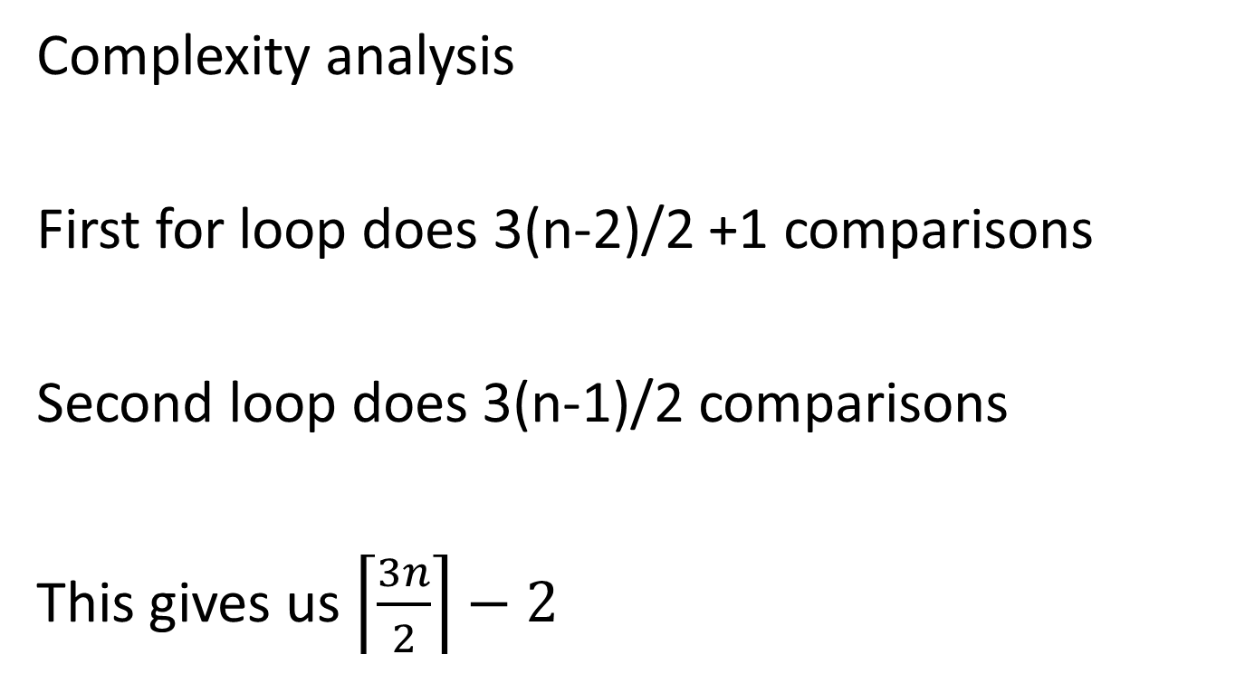
Max and Min in List
Complexity analysis
First for loop does 3(n-2)/2 +1 comparisons
Second loop does 3(n-1)/2 comparisons
This gives us $\left\lceil \left.\frac{3n}{2}\right\rceil −2\right.$

